Slide 1
Oregon Science Olympiad New Coaches’ Workshop
11.01.24
Ashley da Silva

Slide 2
What is Science Olympiad?
Science Olympiad is a national program that develops a variety of tournament events in science & engineering. They also help plan the national tournament.
Oregon Science Olympiad is the state organization that organizes MS and HS teams and prepares the state tournament.
Link to Oregon’s Website
Link to National Organization Website

Slide 3
Science Olympiad Season
Here is a Timeline Typical of Many Teams:
September | October | November | December | January | February | March - April
Decide to have a team | Recruit students, volunteers, coaches | Organize team; decide events | Have students able to work over break | National Invitational Oregon SO Registration Deadline | Practice tests, including trials for build events | Tournament itself

Slide 4
Where are you on this timeline?
What obstacles do you face right now?
September | October | November | December | January | February | March - April
Decide to have a team | Recruit students, volunteers, coaches | Organize team; decide events | Have students able to work over break | National Invitational Oregon SO Registration Deadline | Practice tests, including trials for build events | Tournament itself

Slide 5
Role of the Coach
Help students obtain the money listed in their budget
Help students acquire practice space and materials
Fill out tournament paperwork
Assist team captains with coordinating necessary forms
Provide supervision and food at tournament
Leave most roles to students
Should be a faculty member at student’s school (because of student privacy / medical needs)
A parent or parents can be assistant coach(es)

Slide 6
Role of the Team Captain
Talk to classmates at the beginning of the season regarding what Scioly is and time commitment
Decides teammates for upcoming season (through tryout results, prior STEM experience, etc.)
Organize weekly meetings for studying & building
Play key role in organizing events of teammates
Work with build event teammates to create a budget
Determine methods to obtain the money necessary (work with coach/mentor)
Help coach coordinate team for tournament
SO Student Advice
Student Discord

Slide 7
Team Members
B Division = Middle School
C Division = High School
1-15 students from same school
Special rules from national organization linked here
You do not have to have membership finalized before registration

Slide 8
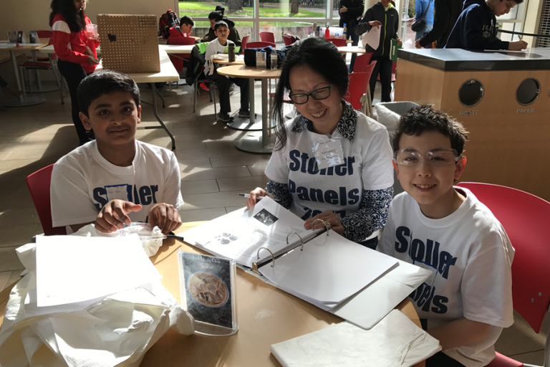
Good Ideas at Practices
Frequency of Practices
Science Olympiad recommends weekly practices after students have been assigned to events
Provide access to tools & tech
Monitor progress & solve problems
Inform students of available practice opportunities, help them find practice tests, videos, etc.
High school students often can organize themselves to practice
Consider:
Having smaller groups of students meet (eg, those doing lab events)
Asking for community locations vs. only at schools
Virtual prep, like Zoom meetings or Discord

Slide 9
Who is on your team so far and/or what are your ideas for recruiting members?
Who is supporting your team and/or who might be available to help?
What is your practice schedule like?

Slide 10
About the Tournament
Sunday, March 16 at University of Portland
Tournament Schedule Posted at oregonscienceolympiad.org
When assigning students to events, think about...
who is interested in each topic -- let students have fun :)
whether you want a high team score -- if so, joining more events is better -- or want to aim only for event awards
schedule conflicts: please note that any student team member may attend a build event device testing and that students outside of the official partnership/trio can help with preparation for other events

Slide 11
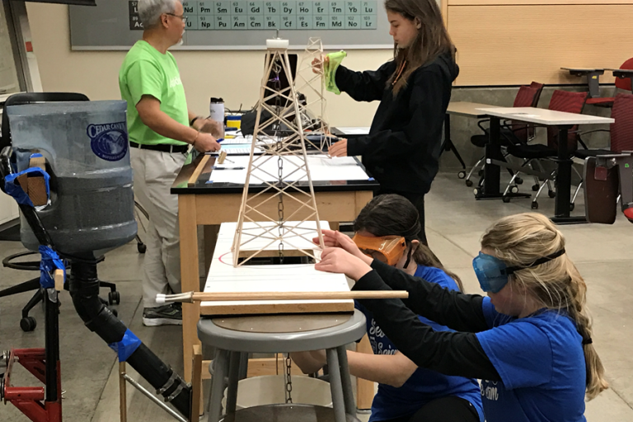
Types of Events
“Build” or Engineering Events:
Teams create structures, vehicles, or devices prior to the competition and have them tested at the competition.
“Lab” Events:
Teams complete hands-on procedures on-site using materials that are provided and/or brought by the team members.
“Knowledge” Events:
Teams complete a written test, which may involve specimens to identify, calculations, a slideshow, and/or limited hands-on work.
Note: some events fit more than one category

Slide 12
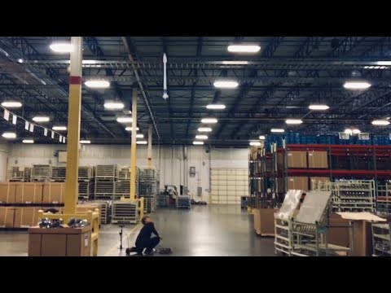
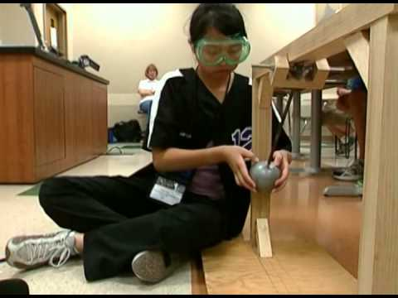
Build Event Examples

Slide 13
Special Challenges for Build Events
understanding the rules -- they are complex, and not following them affects scoring a lot
testing and collecting data
many events give points for a log of observations
many devices must be customized to fit parameters on-site
Events that fit this category:
Tower (B/C)
Air Trajectory (B/C)
Electric Vehicle (C) and Scrambler (B)
Helicopter (B/C)
Bungee Drop (C)
Mission Possible (B) and Robot Tour (C)
Wind Power (B/C) - also has knowledge component

Slide 14
Which build events are your students most interested in?
Which seem the most confusing and/or logistically challenging?

Slide 15
Special Challenges for Lab Events
assembling a bin of materials / ensuring safety
calculator requirements vary, see Rules Manual
practice with typical lab activities
students should be able to follow and/or devise their own procedures and interpret the results quickly
Events that fit this category:
Chemistry Lab (C) and Materials Science (C)
Crime Busters (B) and Forensics (C)
Potions & Poisons (B) and Metric Mastery (B)
Codebusters (B/C)
Experimental Design (B/C)
Write It, Do It (B/C)
Optics (B/C) & Microbe Mission (B/C) - have lab components

Slide 16
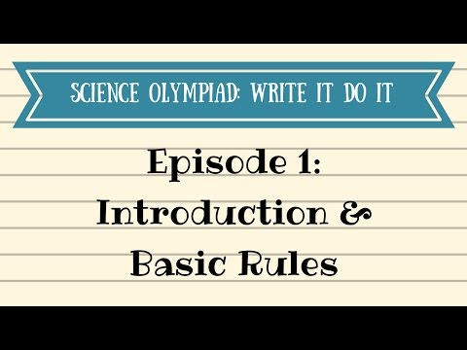
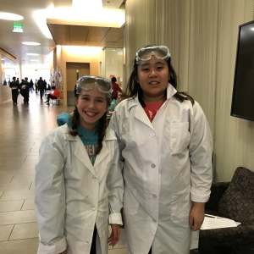
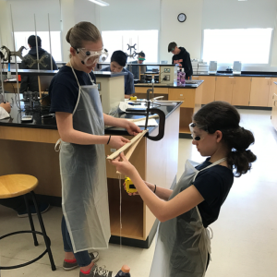
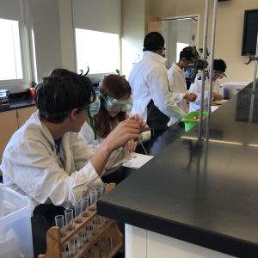
Lab Event Examples

Slide 17
Which lab events are your students most interested in?
Which seem the most confusing and/or logistically challenging?

Slide 18
Special Challenges for Knowledge Events
organizing notes into a binder or usable notes page
partners may use copies of the same resource to avoid sharing OR have resources that add up to the allowed notes
check calculator rules for each event in Rules Manual
take practice test using the notes to build fluency + revise them
be able to interpret images, graphs, science data sets
Events that fit this category:
Anatomy & Physiology (B/C) and Disease Detectives (B/C)
Reach for the Stars (B) and Astronomy (C)
Optics (B/C) & Microbe Mission (B/C) - have lab components
Wind Power (B/C) - also has device building
Dynamic Planet: Glaciers (B/C) & Ecology (B/C)
Fossils (B/C) & Entomology (B/C)
Road Scholar (B) & Geologic Mapping (C) & Meteorology (B)

Slide 19
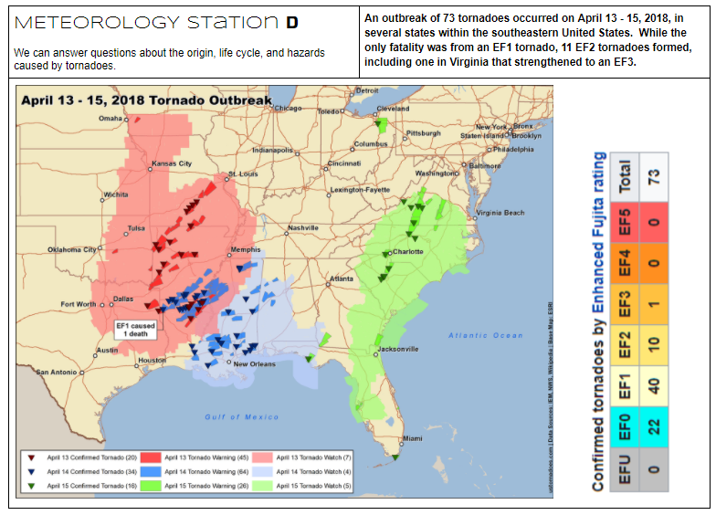
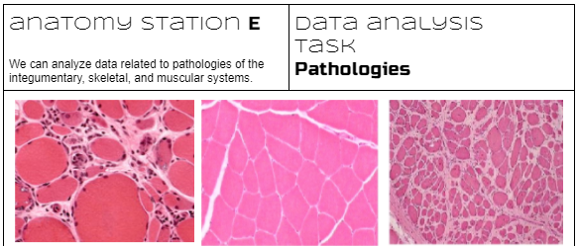
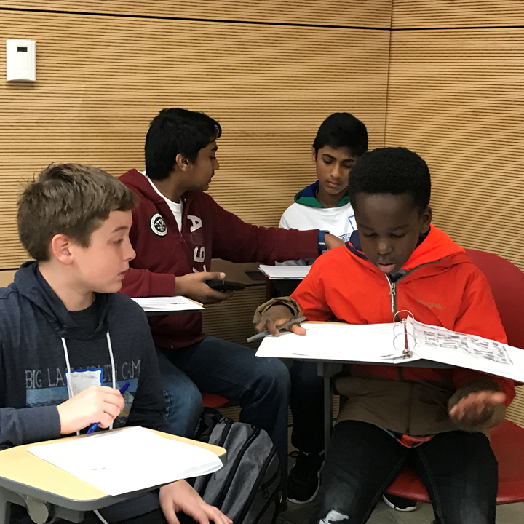
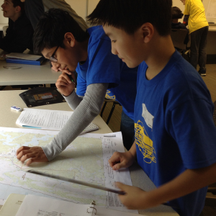
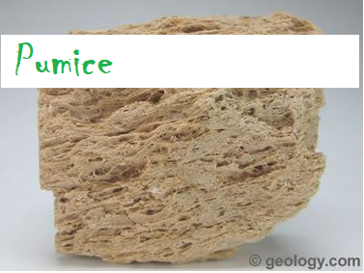
Knowledge Event Examples

Slide 20
Which knowledge events are your students most interested in?
Which seem the most confusing and/or logistically challenging?

