Slide 1
Oregon Science Olympiad New Coaches’ Workshop
10.27.21
Ashley da Silva

Slide 2
Workshop Agenda
12:30 - 12:45 Team Members 5:30 - 5:45
12:45 - 1:00 General Timeline 5:45 - 6:00
1:00 - 1:15 About the Tournament 6:00 - 6:15
1:15 - 1:45 Finding Resources 6:15 - 6:45
1:45 - 2:00 Build Events 6:45 - 7:00
2:00 - 2:15 Lab Events 7:00 - 7:15
2:15 - 2:30 Knowledge Events 7:15 - 7:30
link to Padlet for interactivity:
https://padlet.com/ashley_dasilva/vmldn1dyxpqsqyck

Slide 3
Team Members
Up to 15 members from the same school,* plus alternates
It’s fine to start small! There isn’t a minimum size.
Up to 3 teams per school register before Jan 31st, additional may be possible afterwards
The fine print, from the Science Olympiad national site:
A Division C (high school) team can have a maximum of seven (7) 12th grade students.
Division B “Returning Students” A maximum of five (5) 9th grade students is permitted on a Division B team. Because middle schools that do not have grades 7, 8 or 9 are at a slight disadvantage, they may invite any combination of up to five (5) of their last year's 6th, 7th or 8th grade students to be part of the team. Possible examples/scenarios:
A school with grades X-9 can only have 5 students from grade 9 (in their current enrollment)
A school with grades X-8 can only bring back 5 students from grade 9 (from the previous year's enrollment of 8th grade students)
A school with grades X-6 can only bring back 5 students from grades 7, 8 or 9 (who had been previously enrolled in that school as a 6th grader)

Slide 4
Coaches, Volunteers, and School Liaisons
The Coach is the point of contact for the team.
Register the team for the state program
Complete tournament paperwork
Get newsletters, share news, decide on invitationals
Decide which students do which events
Parent and/or Community Volunteers help students prepare.
Interpret rules, acquire resources and workspace
Sign up students for mySO practices
Cannot build or write notes
School Liaisons help with school-related things.
busing to on-site tournament site
space and volunteers for satellite tournaments

Slide 5
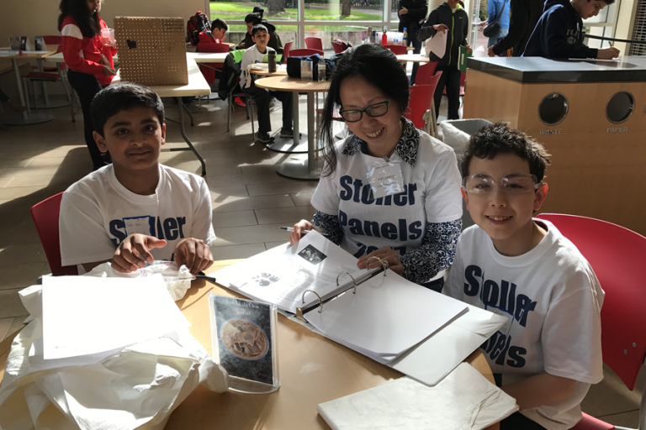
Science Olympiad Practices
Frequency of Practices
Science Olympiad recommends weekly practices after students have been assigned to events
Provide access to tools & tech
Monitor progress & solve problems
Inform students of available practice opportunities, help them find practice tests, videos, etc.
High school students often can organize themselves to practice
Recommended Strategies
Because COVID
Consider:
Having smaller groups of students meet (eg, those doing lab events)
Asking for community locations vs. only at schools
Virtual prep, like Zoom meetings or Discord

Slide 6
A General Timeline
Watch for monthly newsletters
These will be posted on oregonscienceolympiad.org
There are various invitationals nationwide (must register 1st)
mySO prep & practice tests occur seasonlong
tournament is usually in April, but may be in March this year due to earlier National Tournament on May 14th CalTech
September | October | November | December | January | February | March - April
Decide to have a team | Recruit students, volunteers, coaches | Organize team; decide events | Have students able to work over break | National Invitational Oregon SO Registration Deadline | Practice tests, including trials for build events | Tournament itself

Slide 7
Where are you on this timeline?
What obstacles do you face right now?
September | October | November | December | January | February | March - April
Decide to have a team | Recruit students, volunteers, coaches | Organize team; decide events | Have students able to work over break | National Invitational Oregon SO Registration Deadline | Practice tests, including trials for build events | Tournament itself
https://padlet.com/ashley_dasilva/vmldn1dyxpqsqyck

Slide 8
About the Tournament
Here’s a link to the tournament schedule (draft)
https://docs.google.com/spreadsheets/d/1DLhxLDkB7AtjpZMocH6d973s5tyDfxKhF1G3k7APXh4/edit?usp=sharing
It is similar to the National Tournament
There is a 2-month feedback window for changes, which began the first week of October
When assigning students to events, think about...
who is interested in each topic -- let students have fun :)
whether you want a high team score -- if so, joining more events is better -- or want to aim only for event awards
schedule conflicts: please note that any student team member may attend a build event device testing and that students outside of the official partnership/trio can help with preparation for other events

Slide 9
Tournament Style
You may hear of different Science Olympiad tournament styles
miniSO = all-online option, usually through Scilympiad
many invitationals are being run this way
satellite SO = students gather at their home schools with challenges that may be mailed and/or online
the National Tournament will be run this way
We have not yet selected a tournament style, but hope to by the November update (I know that is soon!)
biggest challenge right now is venue for in-person
we may do a reduced in-person tournament with build events and certain lab events on-site and the others done at student schools in a “satellite” format
we won’t be doing a fully-online event this year

Slide 10
Finding Resources
Kinds of Resources
One of the most important things coaches and parent/community volunteers can do is find resources
Provide access to tools & tech
Provide gym space to test build events / lab space to do lab practice
help coordinate mySO practice tests
find guest speakers from the community -- this is a fun thing to do if possible and helps students consider science & technology careers!
The Science Olympiad National Organization store sells old tests, hands-on kits, and other event prep materials
Recommended Strategies
Science Olympiad “Great Tips for Students”
Link to This Document
Understanding Event Rules is a very important first step
Coaches and volunteers can help
You can also ask me about rules! If I don’t know, I’ll figure out

Slide 11
Web Resources
Science Olympiad National Site
www.soinc.org
Go here for:
Event Rules + updates
mySO Practice Tests
Some event prep materials
Also have a youtube channel with video of past events esp. build events
Oregon Science Olympiad
www.oregonscienceolympiad.org
Go here for:
Team registration & payment
Tournament info, including invitationals
Schedule and (by Jan) event formats
That could be important for your team
Science Olympiad Student Wiki
www.oregonscienceolympiad.org
Go here for:
Student-made info on events
also check QUIZLET for info
A forum to ask questions
more practice tests

Slide 12
Which web resources have you already explored?
After taking a brief look, what would you want to try?
Is there anything you wish existed on oregonscienceolympiad.org that doesn’t right now? I might be able to add it….
https://padlet.com/ashley_dasilva/vmldn1dyxpqsqyck

Slide 13
Types of Events
Science Olympiad events will fall under one or more of these general categories:
“Build” or Engineering Events:
Teams create structures, vehicles, or devices prior to the competition and have them tested at the competition.
“Lab” Events:
Teams complete hands-on procedures on-site using materials that are provided and/or brought by the team members.
Note: some events fit more than one category
“Knowledge” Events:
Teams complete a written test, which may involve specimens to identify, calculations, a slideshow, and/or limited hands-on work.

Slide 14
Build Events
Special Challenges for Build Events
understanding the rules -- they are complex, and not following them affects scoring a lot (tier system)
testing and collecting data
many events give points for a log of observations
many devices must be customized to fit parameters on-site
Events that fit this category:
Bridges (B/C)
Ping Pong Parachute (B/C)
Mousetrap Vehicle (B) and Gravity Vehicle (C)
Storm the Castle (B) and Trajectory (C)
Mission Possible (B) and Sounds of Music (B)
Detector Building (C) and It’s about Time (C)
Electric Wright Stuff (B) and Wright Stuff (C)

Slide 15
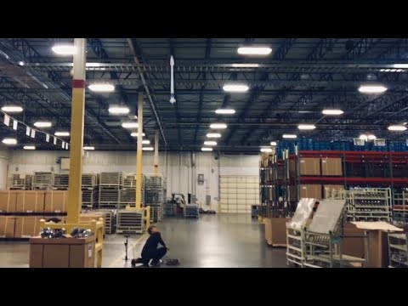
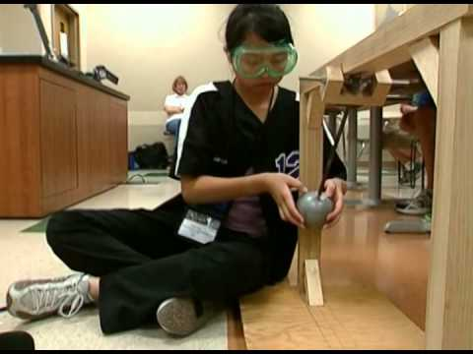
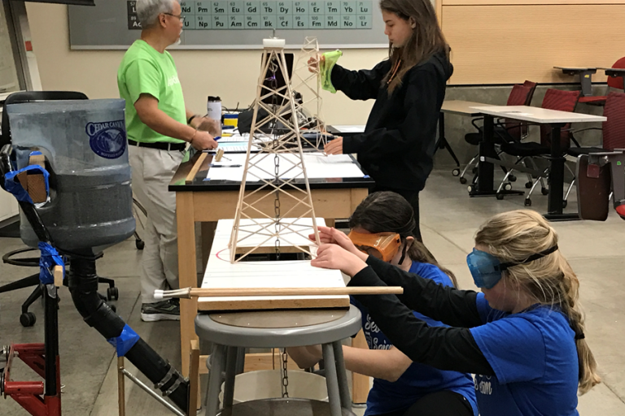
Build Event Examples

Slide 16
Which build events are your students most interested in?
Which seem the most confusing and/or logistically challenging?
https://padlet.com/ashley_dasilva/vmldn1dyxpqsqyck

Slide 17
Lab Events
Special Challenges for Lab Events
assembling a bin of materials / ensuring safety
calculator requirements vary, see Rules Manual
practice with typical lab activities
students should be able to follow and/or devise their own procedures and interpret the results quickly
Events that fit this category:
BioProcess Lab (B) and Food Science (B)
Chemistry Lab (C) and Environmental Chemistry (C)
Crime Busters (B) and Forensics (C)
Detector Building (C) and It’s About Time (C) -- also Build
Codebusters (B/C)
Experimental Design (B/C)
Write It, Do It (B/C)

Slide 18
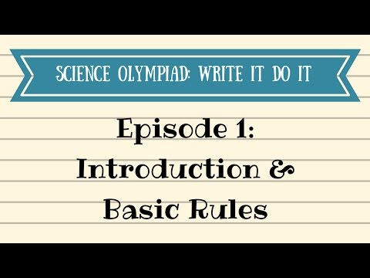
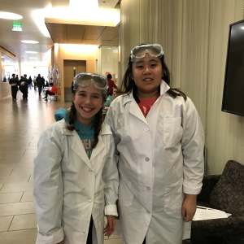
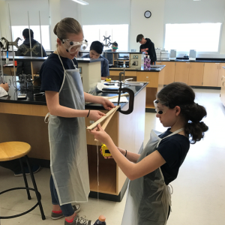
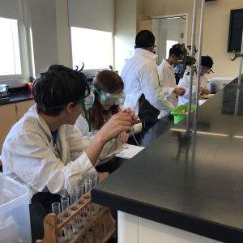
Lab Event Examples

Slide 19
Which lab events are your students most interested in?
Which seem the most confusing and/or logistically challenging?
https://padlet.com/ashley_dasilva/vmldn1dyxpqsqyck

Slide 20
Knowledge Events
Special Challenges for Knowledge Events
organizing notes into a binder or usable notes page
partners may use copies of the same resource to avoid sharing OR have resources that add up to the allowed notes
check calculator rules for each event in Rules Manual
take practice test using the notes to build fluency + revise them
be able to interpret images, graphs, science data sets
Events that fit this category:
Anatomy & Physiology (B/C) and Cell Biology (C)
Solar System (B) and Astronomy (C)
Crave the Wave = wave energy (B) & Meteorology = weather (B)
Dynamic Planet: Hydrogeology (B/C) & Green Gen. (B/C)
Ornithology = birds (B/C) and Rocks & Minerals (B/C)
Road Scholar = maps (B) and Remote Sensing (C)

Slide 21
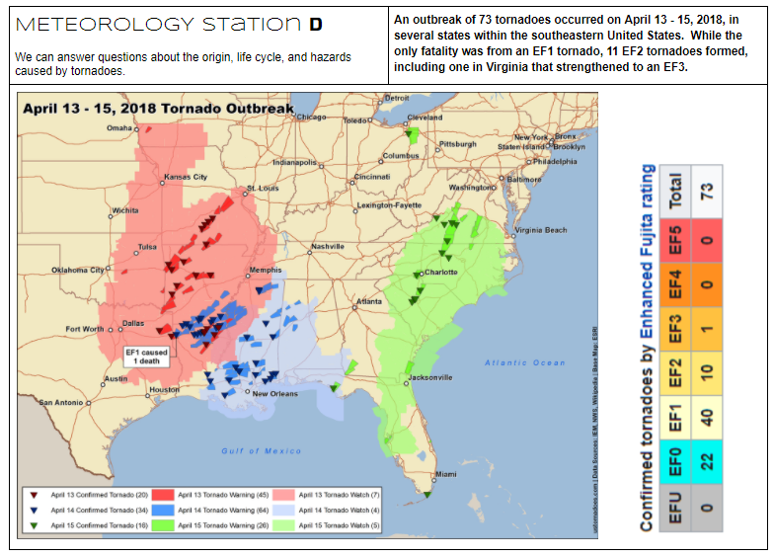
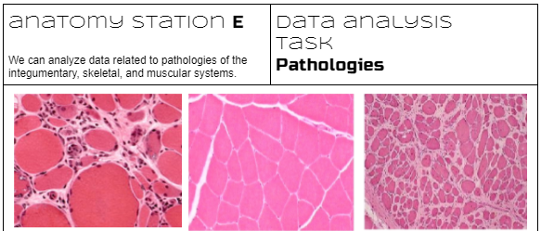
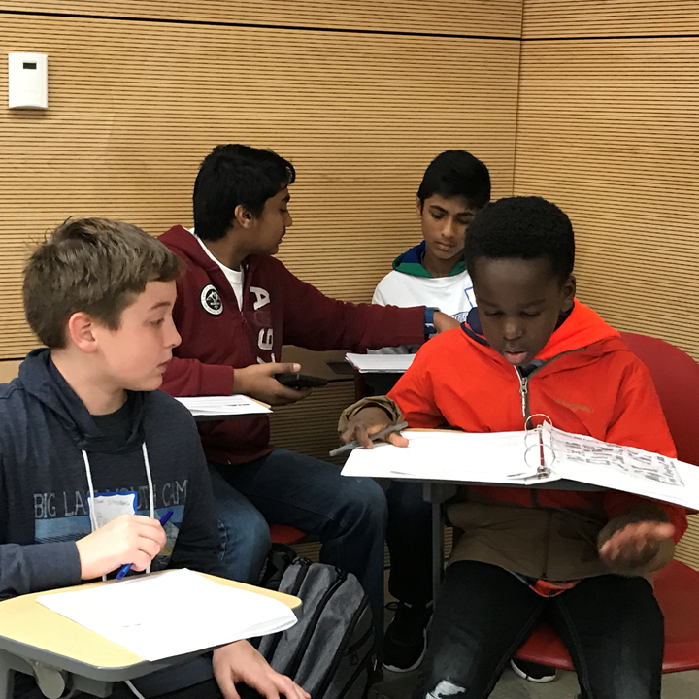
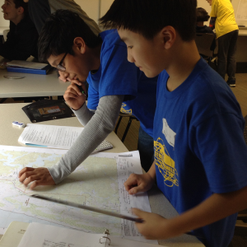
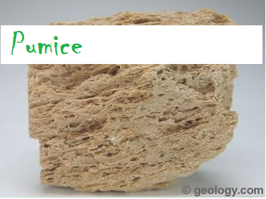
Knowledge Event Examples

Slide 22
Which knowledge events are your students most interested in?
Which seem the most confusing and/or logistically challenging?
https://padlet.com/ashley_dasilva/vmldn1dyxpqsqyck

